Slide 1

Analysis Report

Slide 2

INTRODUCTION
In this report, we delve into the performance metrics of a YouTube channel, examining viewer engagement, content trends, and growth patterns. The analysis aims to identify key factors that influence audience behavior and channel success. By leveraging these insights, we can enhance content strategies to drive higher engagement and sustainable growth on the platform.

Slide 3
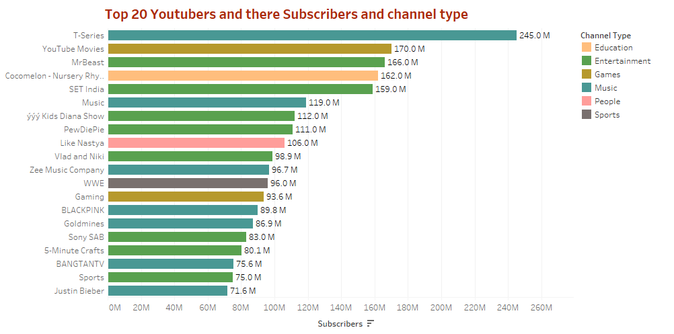
Highest (Peak):
T-Series: 170M subscribers - Channel Type: Music
Lowest:
Justin Bieber: 76M subscribers - Channel Type: Music
Top 3:
T-Series: 170M subscribers - Channel Type: Music
YouTube Movies: 156M subscribers - Channel Type: Entertainment
Cocomelon - Nursery Rhymes: 135M subscribers - Channel Type: Education

Slide 4
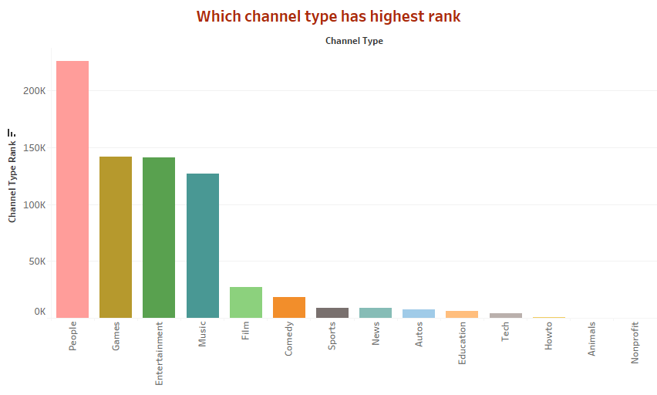

Slide 5
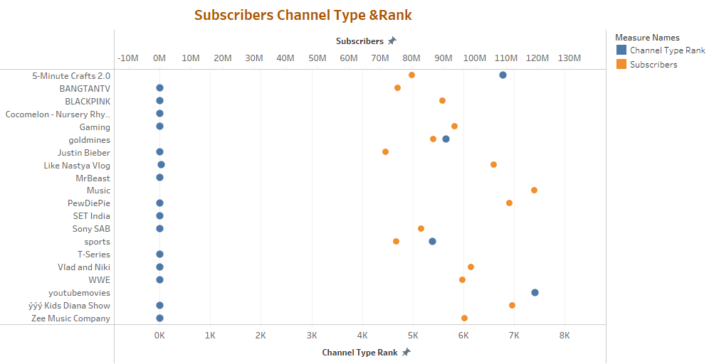

Slide 6
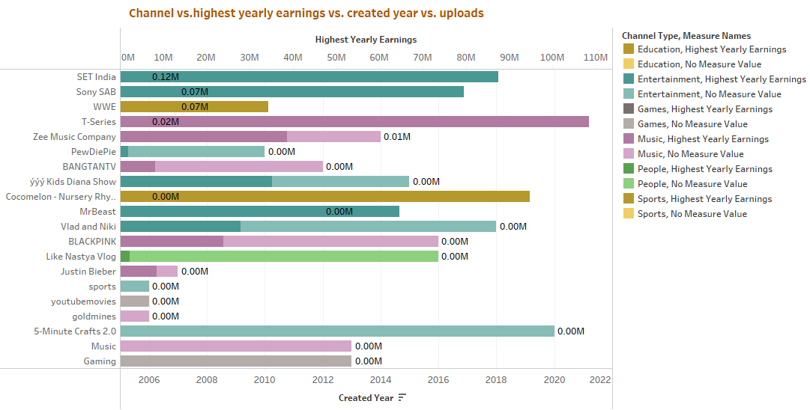

Slide 7
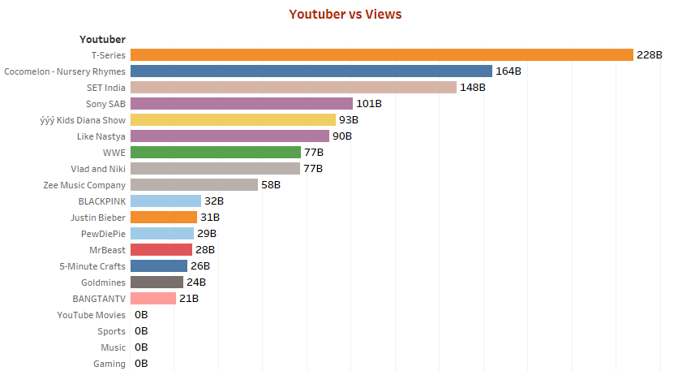

Slide 8
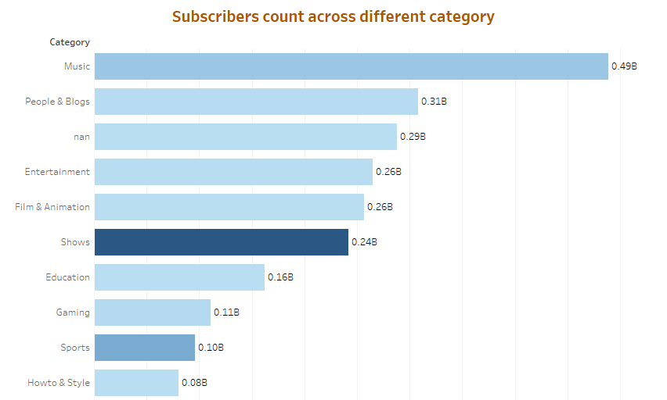

Slide 9
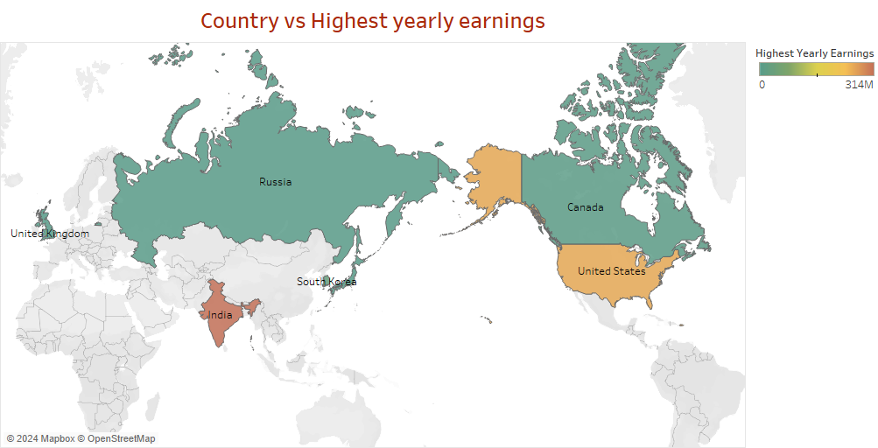

Slide 10
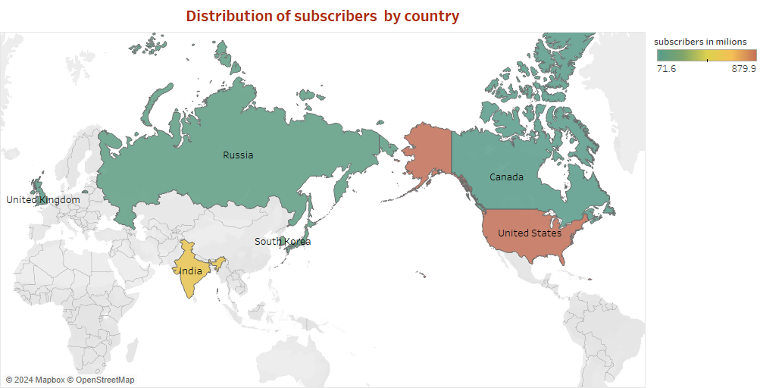

Slide 11
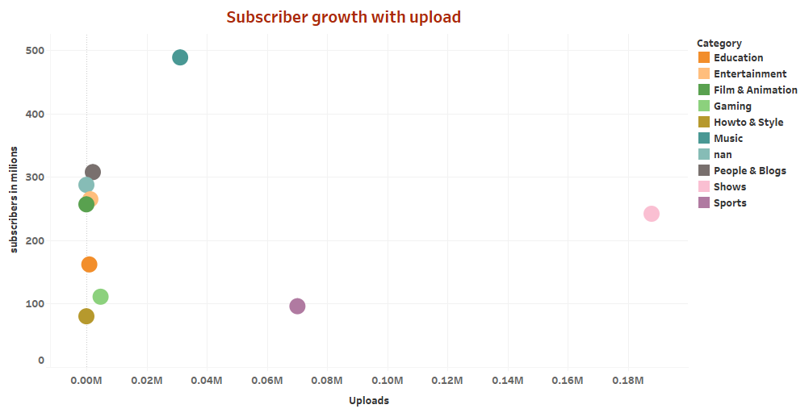

Slide 12
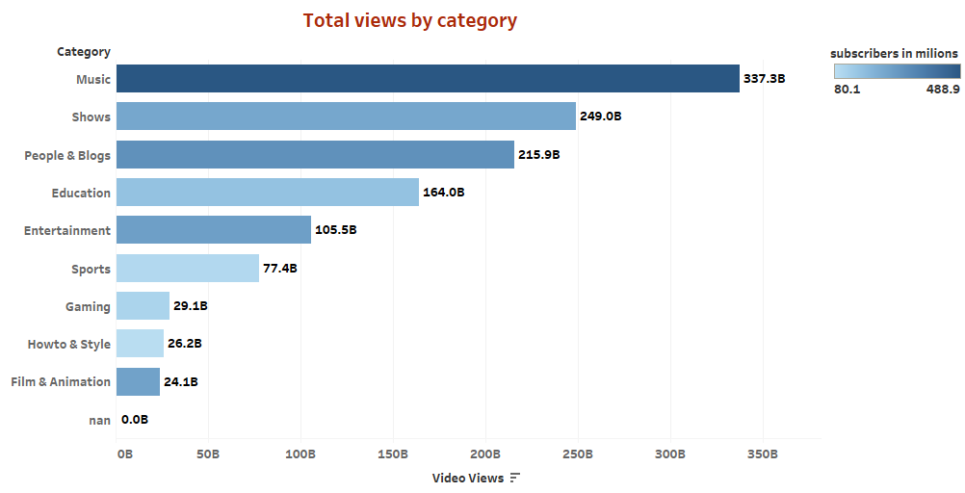

Slide 13
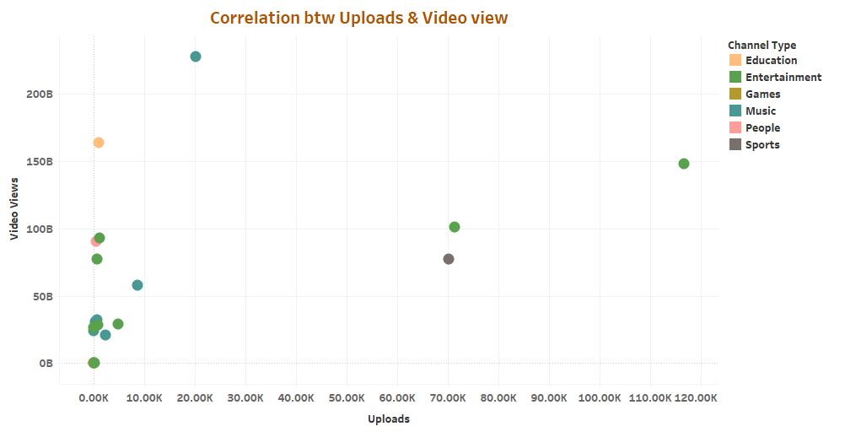

Slide 14
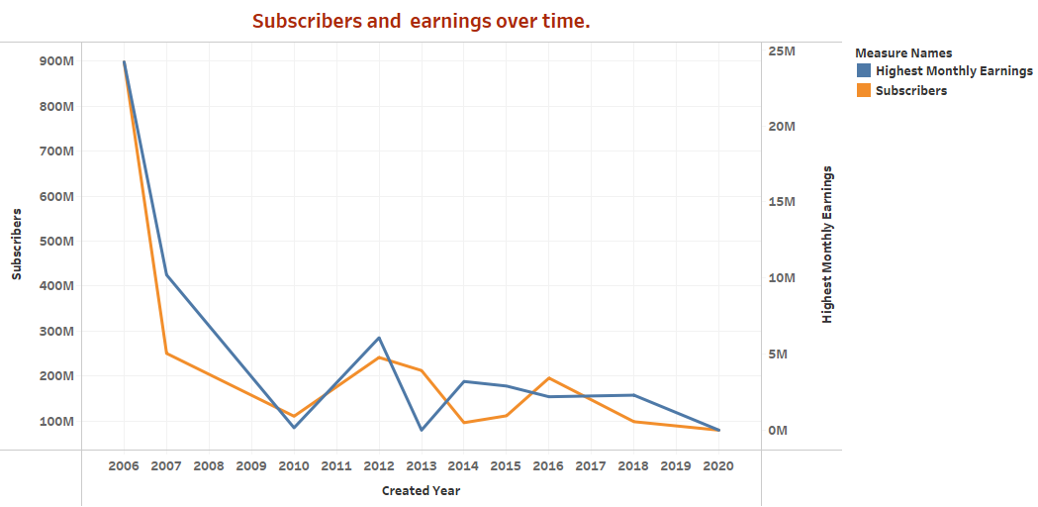

Slide 15
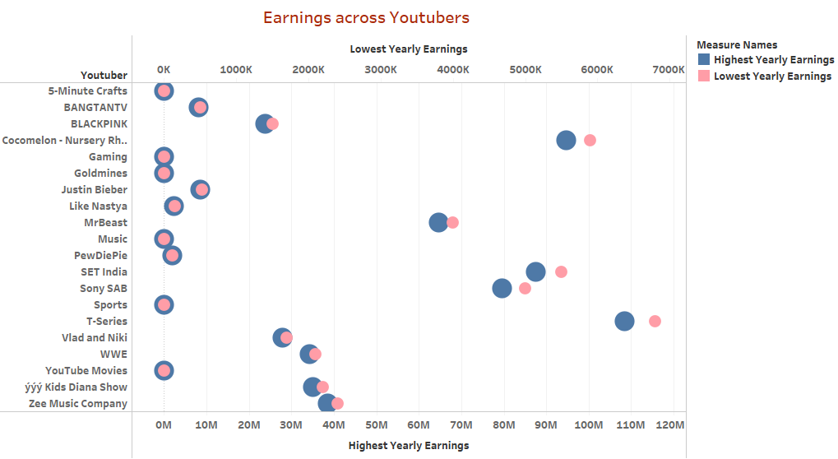

Slide 16
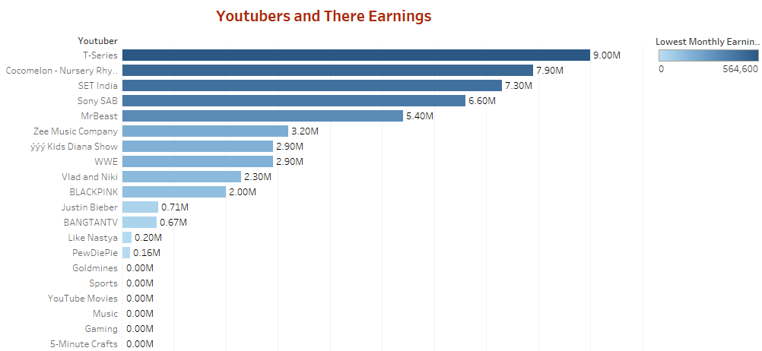

Slide 17
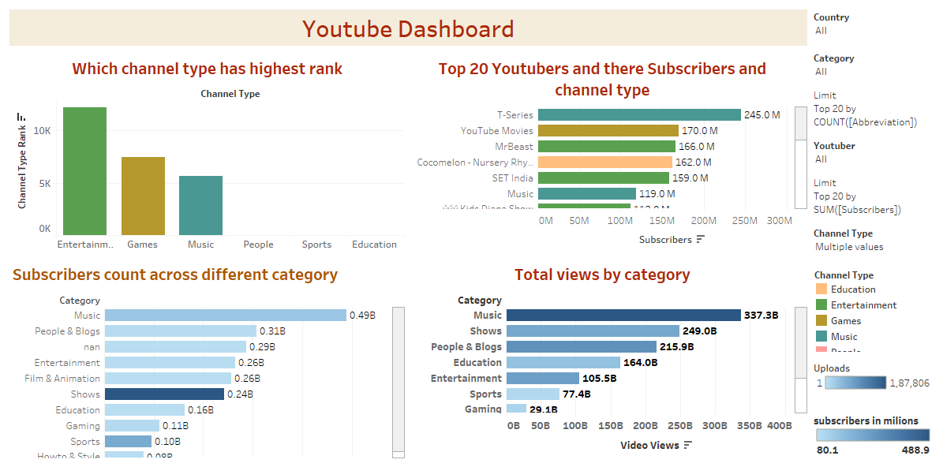

Slide 18
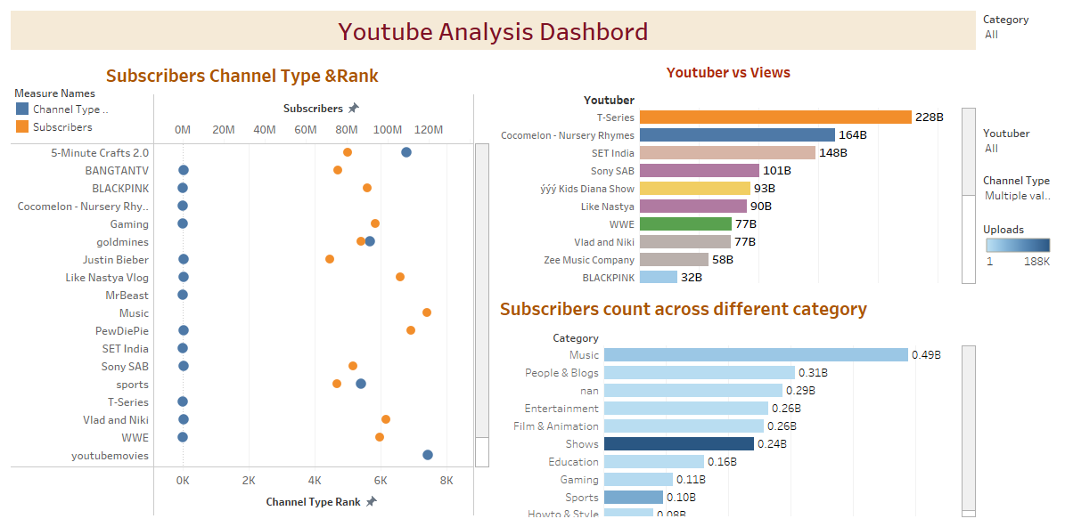

Slide 19
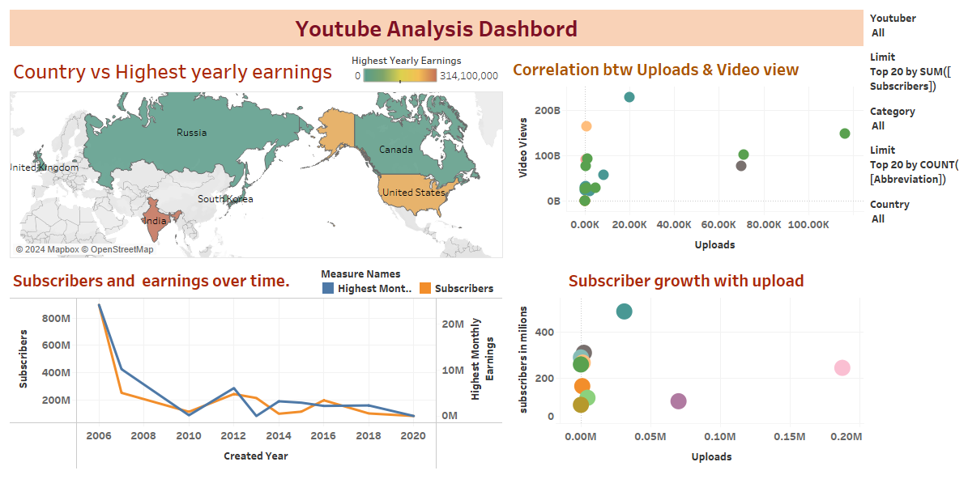

Slide 20
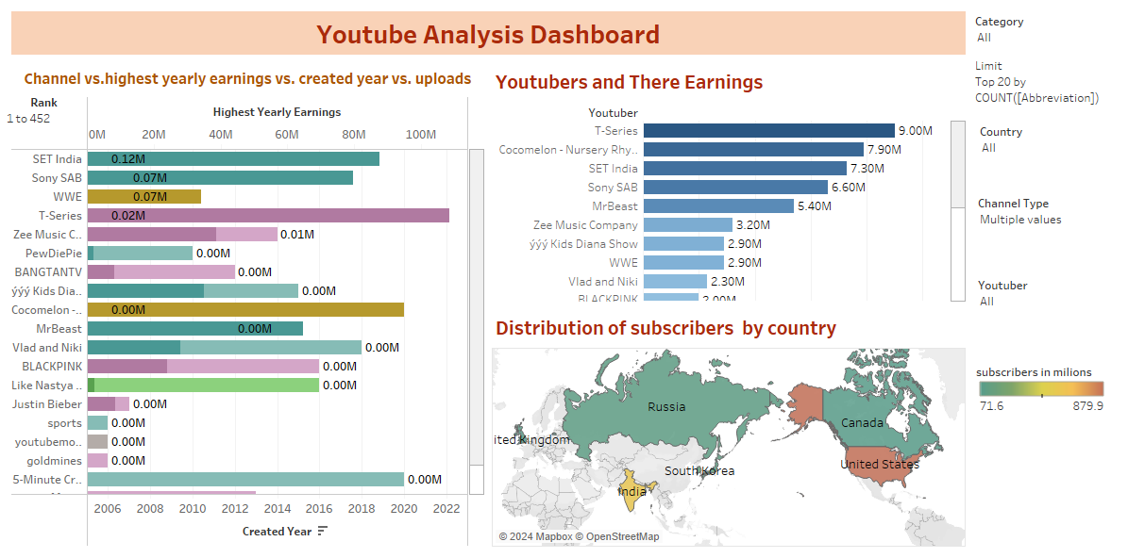

Slide 21

CONCLUSION
YouTube analysis reveals key insights into channel performance, highlighting that factors such as content type, posting consistency, and engagement strategies significantly impact viewer retention and subscriber growth. By applying these findings, the channel can optimize its content strategy to drive better results and enhance overall success on the platform.

Slide 22
THANK YOU
THANK YOU

